Slide 1
Pen & Printers
Sales Analysis
Head of Sales Department
Author Denise Assis
2022, Apr 7th

Slide 2
Case Study Project - Office Supplies
The management at Pens & Printers would like you to look at the data and present to them the popularity of products in each region.
Are there products that do not sell in some locations?
Are there any other patterns over time in each region that you can find in the data?

Slide 3
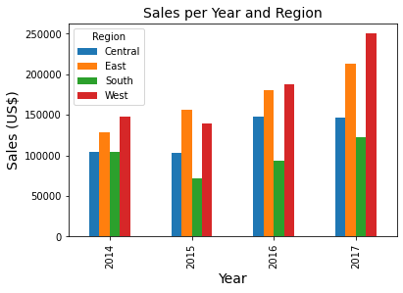
Year Region Sales (US$) Year Region Sales (US$)
2017 West 250128.32 (+ 33%) 2015 West 139966.23 (- 5%)
South 122905.82 (+ 31%) South 71359.95 (- 32%)
East 213082.95 East 156332.00
Central 147098.01 Central 102610.26
2016 West 187480.19 (+ 34%) 2014 West 147883.06
South 93610.22 (+ 32%) South 103845.86
East 180685.95 East 128680.43
Central 147429.39 Central 103838.15

Slide 4
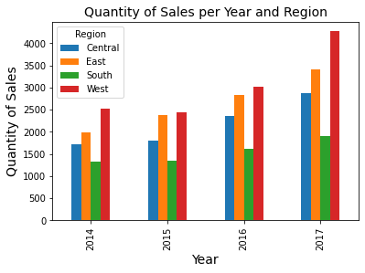
Year Region Quantity Year Region Quantity
2017 West 4270 2015 West 2438
South 1915 South 1344
East 3411 East 2382
Central 2880 Central 1811
2016 West 3025 2014 West 2533
South 1614 South 1336
East 2839 East 1986
Central 2359 Central 1726

Slide 5
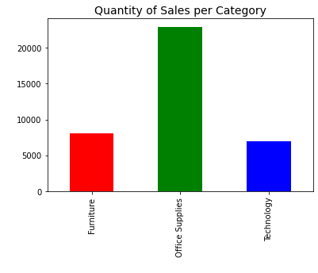
Category Quantity
Furniture 8028
Office Supplies 22906
Technology 6935

Slide 6
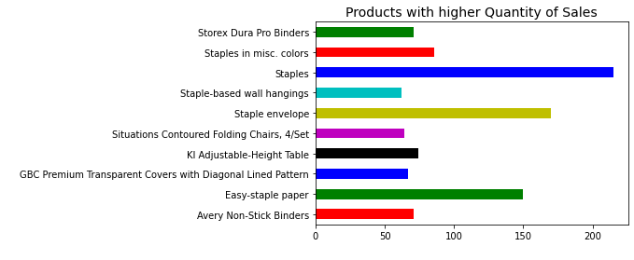
Product Name Category Quantity
Staples Office Supplies 215
Staple envelope Office Supplies 170
Easy-staple paper Office Supplies 150
Staples in misc. colors Office Supplies 86
KI Adjustable-Height Table Furniture 74
Avery Non-Stick Binders Office Supplies 71
Storex Dura Pro Binders Office Supplies 71
GBC Premium Transparent Covers with Diagonal Lined Pattern Office Supplies 67
Situations Contoured Folding Chairs, 4/Set Furniture 64
Staple-based wall hangings Furniture 62

Slide 7
Products with Lower Quantity of Sales and their Order Date
Product Name Category Quantity Region Order Date
Xerox 20 Office Supplies 1 West 12.06.2015
Boston 1900 Electric Pencil Sharpener Office Supplies 1 Central 03.08.2015
Penpower WorldCard Pro Card Scanner Technology 1 South 06.16.2016
Global Enterprise Series Seating Low-Back Chairs Furniture 1 West 08.07.2017
Bush Saratoga Collect 5-Shelf Bookcase, Hanover Cherry Furniture 1 West 12.18.2017
Total Products with Lower Quantity of Sales
(per Region)
Central 59
East 54
South 58
West 68

Slide 8
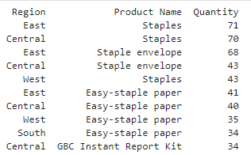
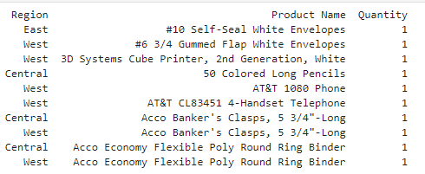
Products with higher and lower quantity of sales and their regions

Slide 9
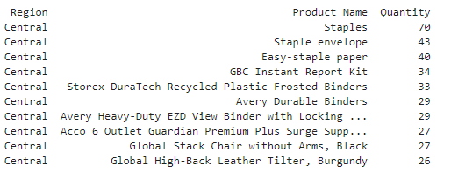
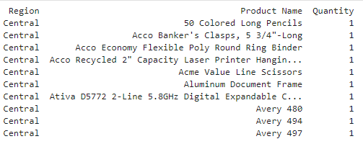
Products with higher and lower quantity of sales at Central Region

Slide 10
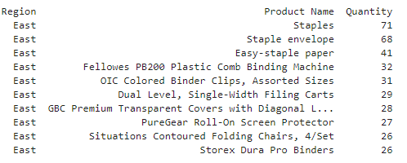
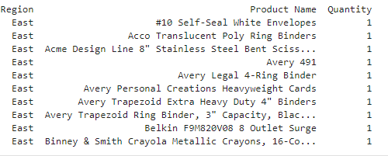
Products with higher and lower quantity of sales at East Region

Slide 11
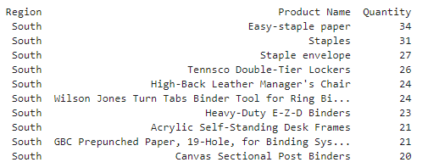
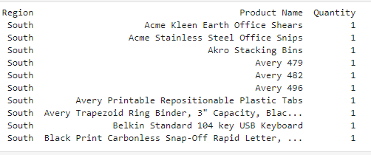
Products with higher and lower quantity of sales at South Region

Slide 12
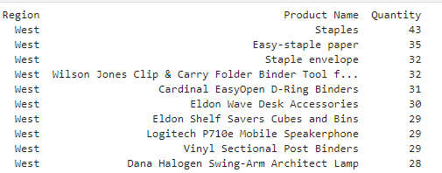
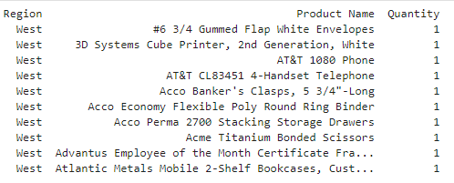
Products with higher and lower quantity of sales at West Region

